Slide 1
Basic in OpenOffice / LibreOffice
Waikato Linux Users Group
Ian Stewart
2021 August 23

Slide 2
History – StarOffice / OpenOffice / LibreOffice
1985: Star Division (Germany) release StarOffice which included StarWriter. C++
1999: Acquired by Sun Microsystems.
2000: Sun release the source code as OpenOffice.
2000-2002: OpenOffice.org XML. Developed as an open community effort by Sun Microsystems.
2005: OpenOffice supports OpenOffice XML document formats.
2006: OpenDocument (ISO/IEC 26300:2006) is based on OpenOffice.org XML.
2010: Sun acquired by Oracle. StarOffice renamed “Oracle Open Office”.
2010: OpenOffice forked to “LibreOffice”.
2011: Oracle donate project to Apache Foundation. Renamed the software “Apache OpenOffice”.
2020: OpenDocument V1.3 Approved.
2021: LibreOffice now has more development / Users than OpenOffice.

Slide 3
History – StarBasic
1990’s: StarBASIC added to product suite.
VBA Mode. Visual Basic for Applications compatibility with MS Office suite.
Code storage choices (Linux):
  System: /usr/lib/libreoffice/share/basic/
  Application: /home/ian/.config/libreoffice/4/user/basic/Standard
  Document (Embedded): Basic/Standard/Module1
Supports other scripting languages: JavaScript, BeanShell and Python
APSO – Alternative Python Script Oganizer.
https://extensions.libreoffice.org/en/extensions/show/apso-alternative-script-organizer-for-python
APSO Development: https://gitlab.com/jmzambon/apso
Python Storage choices (Linux):
  System: /usr/lib/libreoffice/share/Scripts/python
  Application: /home/ian/.config/libreoffice/4/user/Scripts/python
  Document (Embedded): Scripts/python/module.py

Slide 4
Embedded Basic Demo
Demo manually embedding Basic in a Writer document.
Provide a pushbutton.

Slide 5
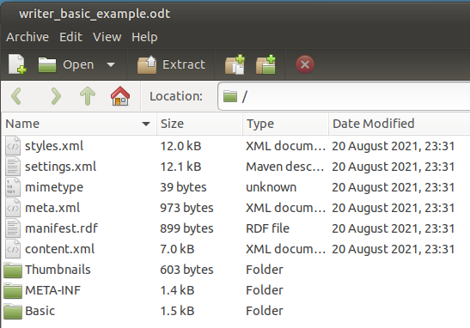
Inside a Writer document with embedded Basic

Slide 6
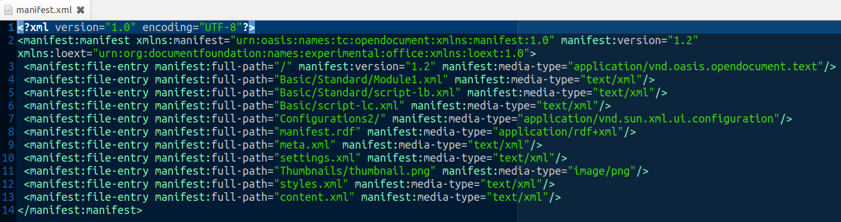
Manifest.xml file
Contains references to three files off the Basic folder.
Module1.xml contains the Basic script.

Slide 7
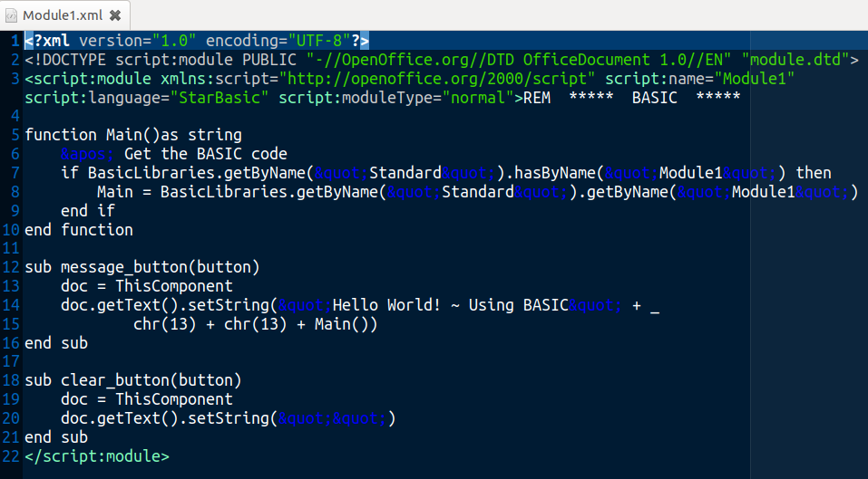
Embedded Basic

Slide 8
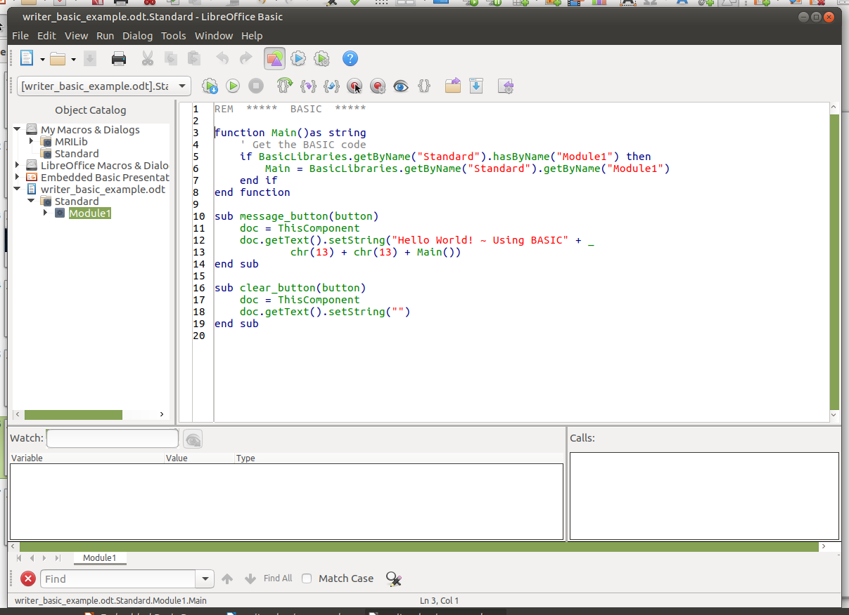
Basic “Hello world” script viewed with IDE

Slide 9
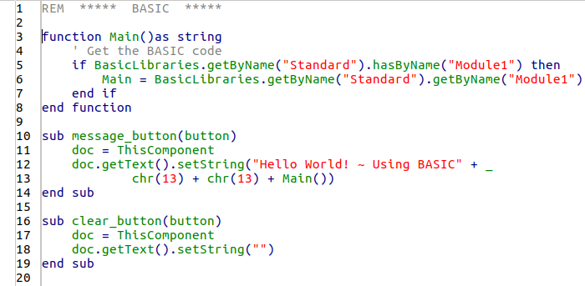
Basic “Hello world” script viewed with IDE - Zoom-in

Slide 10
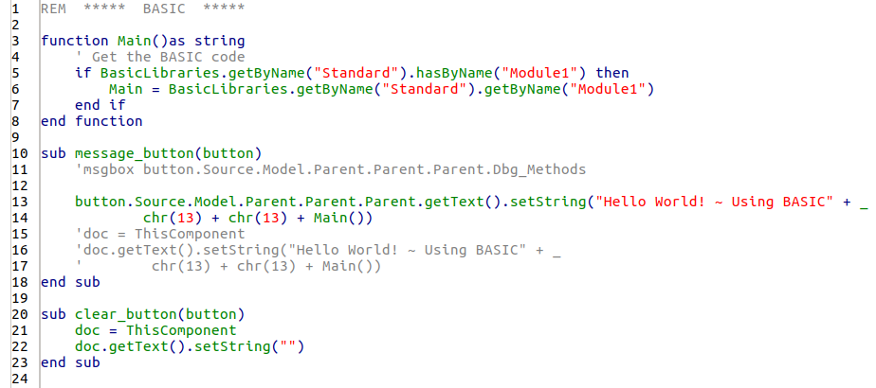
Alternative to doc = ThisComponent

Slide 11
Embedded Basic Demo
Demo Writer example documents.
Basic creates the document.

Slide 12
Using Basic to Create a document
Using Basic to perform Modelling of a document
Avoids manually performing repetative tasks.
Precision in placement of objects. E.g. In Draw application, Lines are accurate to 1/100th of mm.
Allows viewing alternative scenarios.
May turn on and off layers.

Slide 13
Example Basic subroutines creating a Draw document
Sub Main
global_instantiation
clear_elements ' Except for Control Buttons
a4_setup
add_border_layer
add_grid_layer
border_line
border_text_field
compass
grid
grid_supplement
' Measurment lines:
' Pile centers
ruler(3000, 4000, M1 *12, 0, 1500, False)
' Grid square of 1 meter
ruler(3000, 4000, M1, 0, 800, False)
add_pile_layer
End sub

Slide 14
Embedded Basic Demo of Draw document
Demo Draw example documents.
Basic Creates the Document and then allows modelling.
Zoom in to show accuracy.

Slide 15
Embedded Basic to Create Calc Document
Provide scrollbars for modelling parameters.
Scrollbar programming:
  Control section to set Position and Size.
  Model section to set Min Value, Max Value, etc.
  Two listeners. Separate subroutines
Use of “with” statement for chart.

Slide 16
Example of setting the Chart properties...
Chart.Diagram.XAxisTitle.String = "Month"
Chart.Diagram.YAxisTitle.String = "Amount"
Chart.Diagram.HasXAxisGrid = True
Chart.Diagram.XMainGrid.LineColor = RGB(192, 192, 192)
Chart.Diagram.HasYAxisGrid = True
Chart.Diagram.YMainGrid.LineColor = RGB(192, 192, 192)
Chart.PageBackground set until over-ridden by Area.Fillcolor, etc.
Chart.PageBackground.FillBackGround = True
Chart.PageBackground.FillStyle = com.sun.star.drawing.FillStyle.SOLID
Chart.PageBackground.FillColor = RGB(0, 255, 0)
Chart.Diagram.Wall.FillStyle = com.sun.star.drawing.FillStyle.SOLID
Chart.Diagram.Wall.FillColor = RGB(100, 160, 255)
Chart.Diagram.Wall.LineColor = Rgb(80,80,255)
Chart.Diagram.Wall.LineWidth = 80
Chart.Diagram.Wall.LineStyle = com.sun.star.drawing.LineStyle.SOLID ' DASH NONE
Chart.HasMainTitle = True
Chart.Title.String = "Amortization"
Chart.HasSubTitle = True
Chart.Subtitle.String = "Monthly Interest and Principal"
Chart.HasLegend = True
Chart.Legend.Alignment = com.sun.star.chart.ChartLegendPosition.BOTTOM
Chart.Legend.FillStyle = com.sun.star.drawing.FillStyle.SOLID
Chart.Legend.FillColor = RGB(210, 210, 255)
Chart.Legend.CharHeight = 10

Slide 17
Example of setting the Chart properties, using “with” statement...
with Chart
.HasMainTitle = True
.Title.String = "Amortization"
.HasSubTitle = True
.Subtitle.String = "Monthly Interest and Principal"
.HasLegend = True
with .Legend
.Alignment = com.sun.star.chart.ChartLegendPosition.BOTTOM
.FillStyle = com.sun.star.drawing.FillStyle.SOLID
.FillColor = RGB(210, 210, 255)
.CharHeight = 10
end with
with .Diagram
.XAxisTitle.String = "Month"
.YAxisTitle.String = "Amount"
.HasXAxisGrid = True
.XMainGrid.LineColor = RGB(192, 192, 192)
.HasYAxisGrid = True
.YMainGrid.LineColor = RGB(192, 192, 192)
with .Wall
.FillStyle = com.sun.star.drawing.FillStyle.SOLID
.FillColor = RGB(100, 160, 255)
.LineColor = Rgb(80,80,255)
.LineWidth = 80
.LineStyle = com.sun.star.drawing.LineStyle.SOLID
end with
end with
end with

Slide 18
Embedded Basic Demo of Calc document
Demo Calc example document.
Basic Creates the Document and then allows modelling.

Slide 19
Questions?
Future Demos: The same, but using Python.
Files to be posted in:
https://github.com/WLUG/meetings/tree/master/2021/2021-08-23

